Slide 1


Slide 2


Slide 3


Slide 4


Slide 5


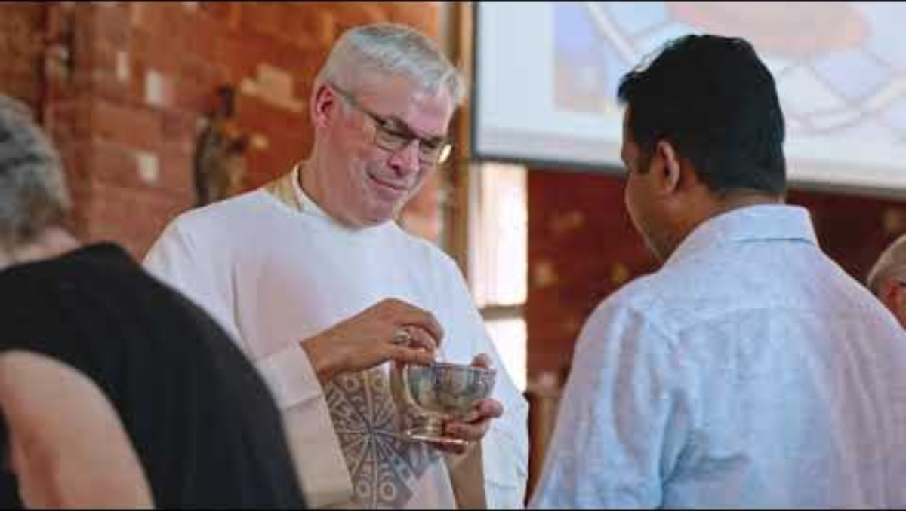

Promotional Film

Slide 6


